Slide 1
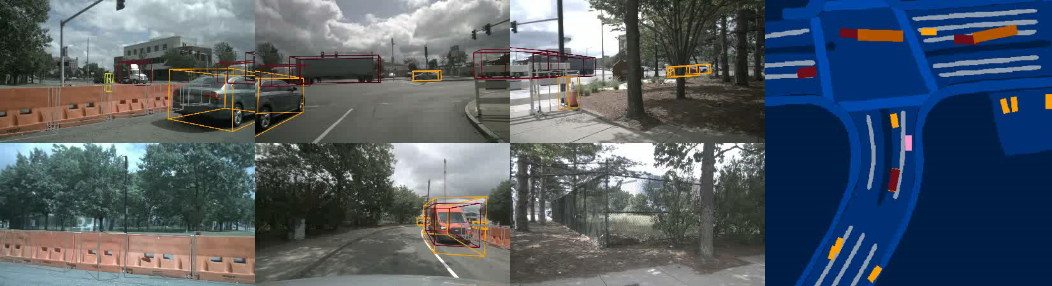




Ego3RT: Learning Ego 3D Representation as Ray Tracing
Jiachen Lu¹, Zheyuan Zhou¹, Xiatian Zhu², Hang Xu³, Li Zhang¹
¹Fudan University ²University of Surrey ³Huawei Noah’s Ark Lab

Slide 2
Multi-view Vision-based 3D Representation Learning
Pedestrians
Bicycle
Lane
Round-view camera
Bird’s Eye View

Slide 3
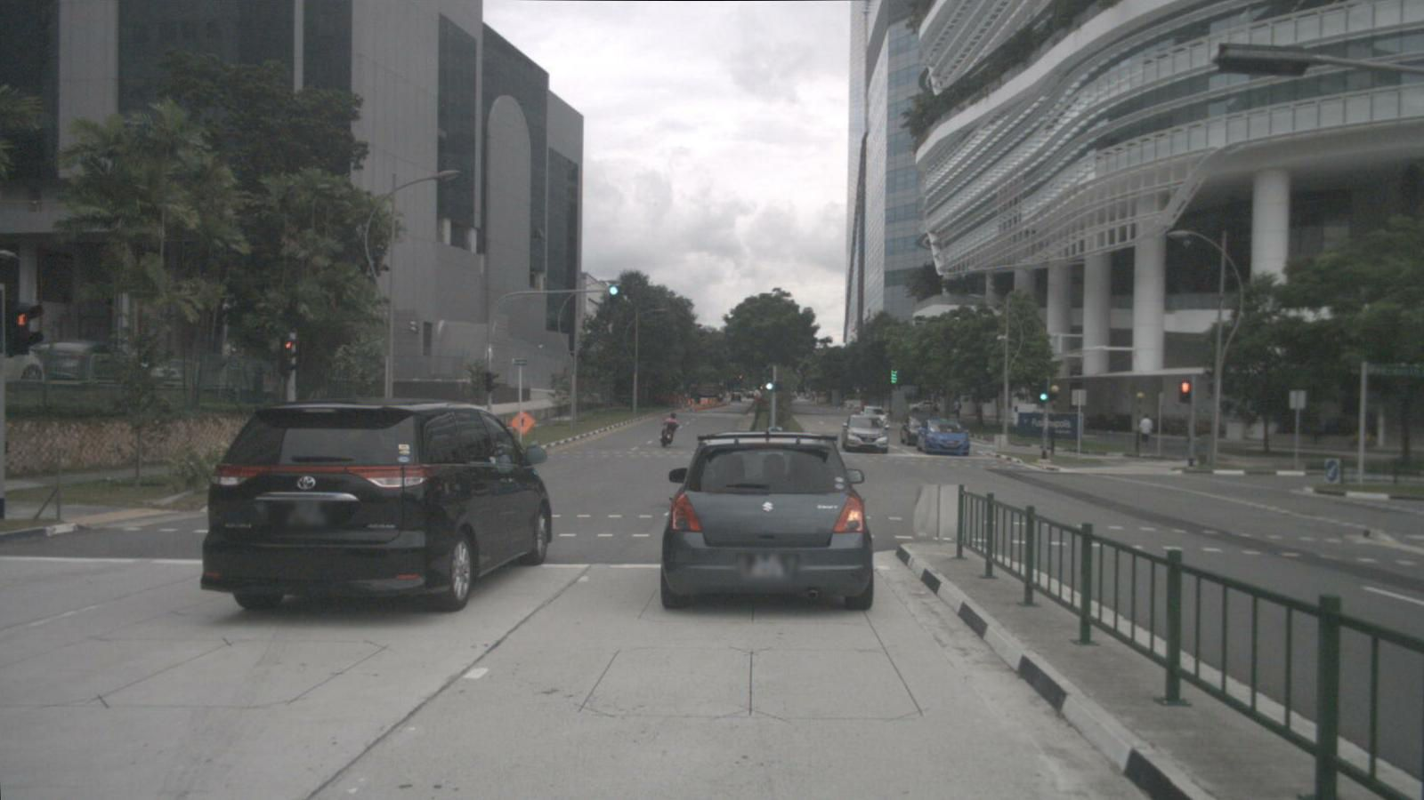
From 2D to 3D
Ego-car coordinate
Ego-sensor coordinate
ill-posed problem
2D
3D

Slide 4
Existing strategies before ECCV2022
Ego-sensor feature
Depth prediction
Philion, et al.: Lift, splat, shoot: Encoding images from arbitrary camera rigs by implicitly unprojecting to 3d.
Hu, et al.: Fiery: Future instance prediction in bird’s-eye view from surround monocular camera.
Reading,et al.: Categorical depth distribution network for monocular 3d object detectio
Ego-car feature

Slide 5
Existing strategies before ECCV2022
Ego-sensor feature
Roddick, et al.: Orthographic feature transform for monocular 3d object detection.
Implicit projection
Roddick, et al.: Predicting semantic map representations from images using pyramid occupancy network.
Saha, et al.: Translating images into maps.
Ego-car feature

Slide 6
Our strategy
Ego-sensor feature
Tracing back
Ego-car feature

Slide 7
Our strategy
Ego-sensor feature
Dynamic Look
Ego-car feature

Slide 8
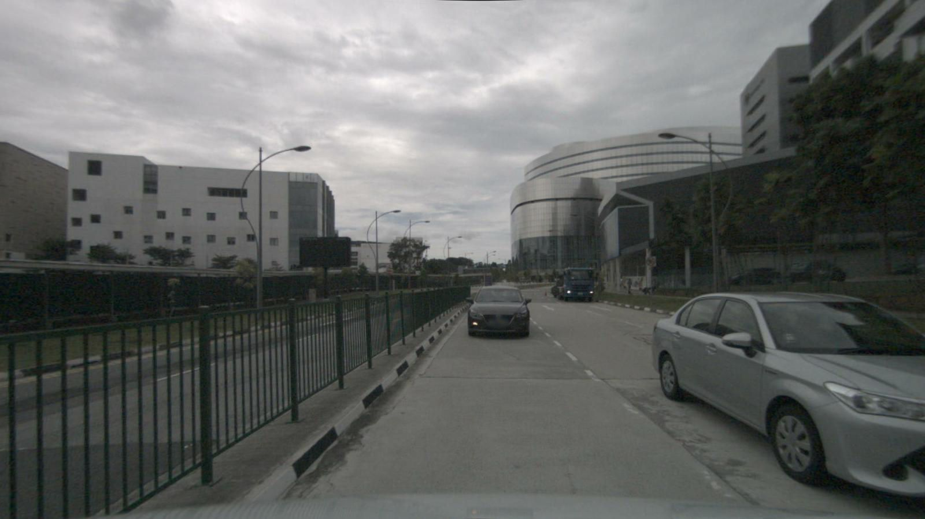
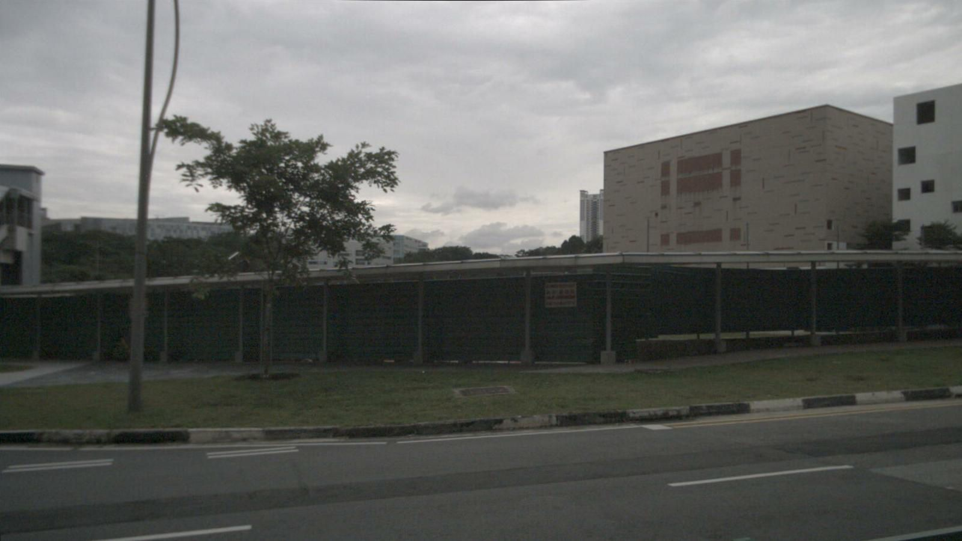
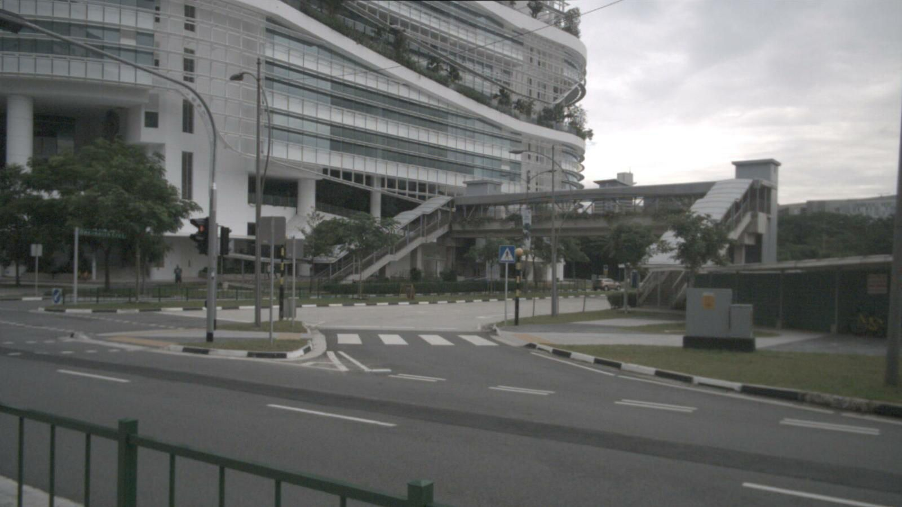
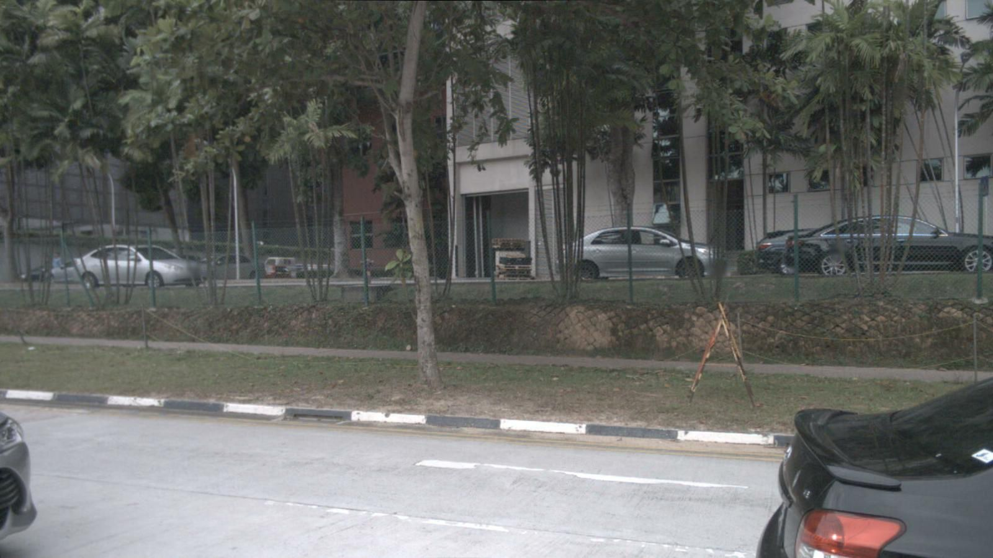
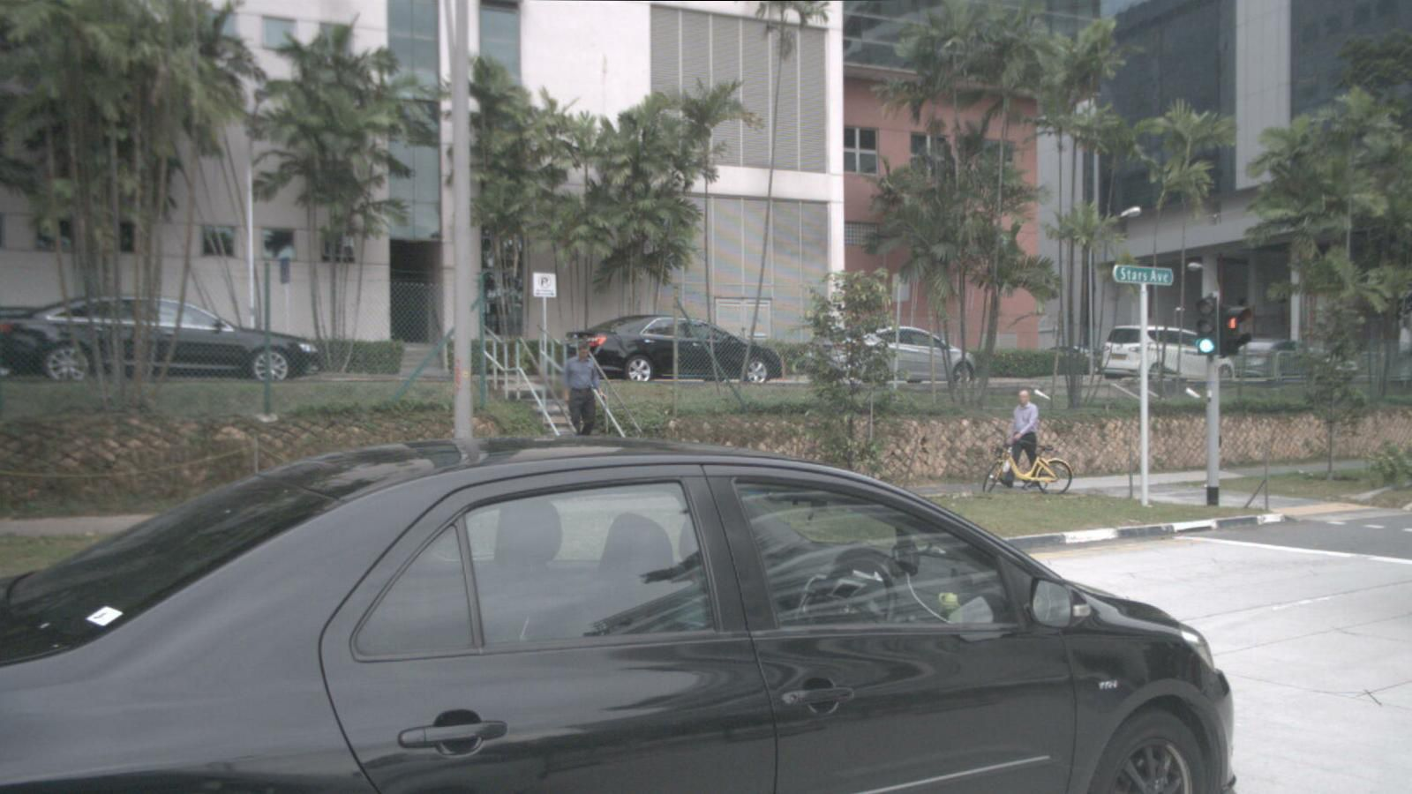

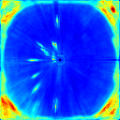
Our strategy: Ego3RT
Ego-sensor feature
Image Backbone
ego 3D representation learning
Ego-car feature
Downstream Head
Detection / Segmentation

Slide 9
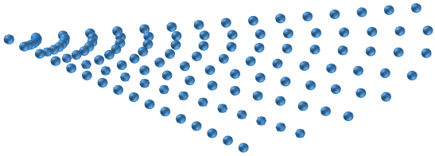
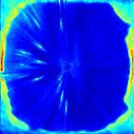
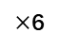
Overview
3D representation
Imaginary eyes
Deformable
attention
&
Polar attention
BEV
encoder
Multi-view
adaptive
attention
Downstream
head
Image feature
extractor
FFN
Image features
Back tracing
Decoder layers
3D object
detection
BEV
segmentation
2D Feature stream
$×$6
3D Feature stream
Sampling
Back tracing stream

Slide 10
Back tracing Decoder layers
Imaginary eyes
Deformable
attention
&
Polar attention
Multi-view
adaptive
attention
FFN
Image features
Back tracing
Decoder layers
$×$6

Slide 11



Imaginary Eyes
eye₃
eye₁
eye₂
$$z$$
$$y$$
$$x$$

Slide 12
Multi-view multi-scale adaptive attention (MVAA)
Imaginary eyes
Feature
Linear
Linear
Softmax
Offsets
Mask
Linear
Ego-sensor feature
Aggregate
Linear
Feature

Slide 13
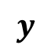


Polarization
Deformable
attention
&
Polar attention
Deformable attention
Multi-view
adaptive
attention
$$z$$
$$y$$
FFN
$$x$$
Back tracing decoder

Slide 14
Polarization
Deformable
attention
&
Polar attention
Polar attention
Multi-view
adaptive
attention
$$z$$
$$y$$
FFN
$$x$$
Back tracing decoder

Slide 15
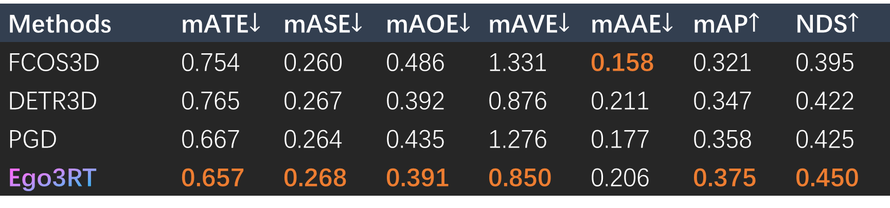
3D Object Detection on nuScenes
Notes:
Wang,et al.: Fcos3d: Fully convolutional one-stage monocular 3d object detection.
Wang, et al.: Detr3d: 3d object detection from multi-view images via 3d-to-2d queries.
Wang, et al: Probabilistic and geometric depth: Detecting objects in perspective.

Slide 16
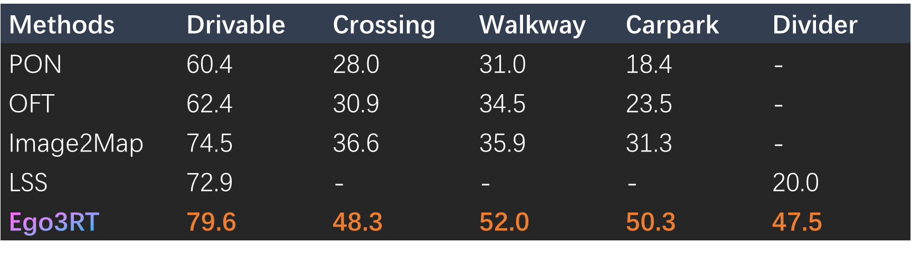
BEV segmentation (single-task) on nuScenes
Notes:
Roddick, et al.: Predicting semantic map representations from images using pyramid occupancy network.
Roddick, et al.: Orthographic feature transform for monocular 3d object detection.
Saha, et al.: Translating images into maps.
Philion, et al.: Lift, splat, shoot: Encoding images from arbitrary camera rigs by implicitly unprojecting to 3d.

Slide 17
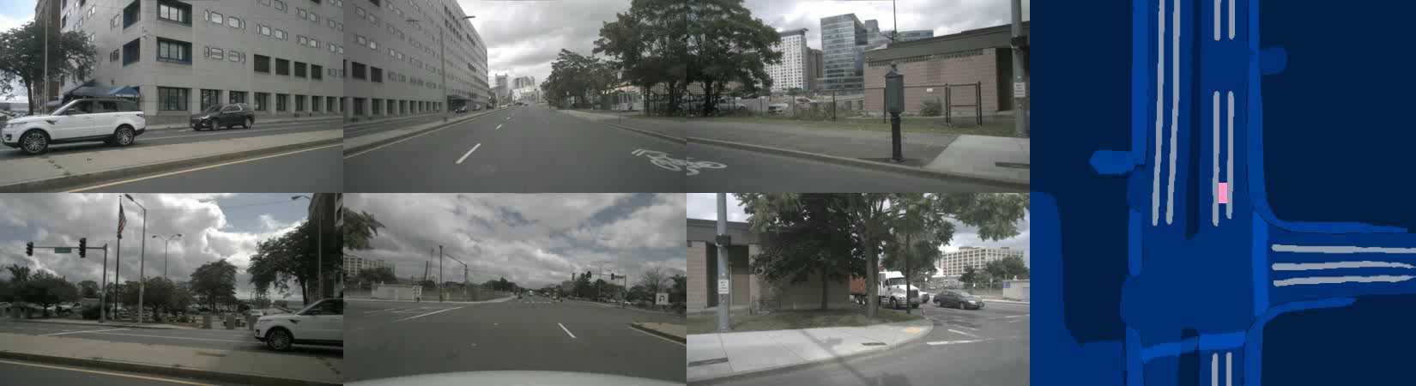
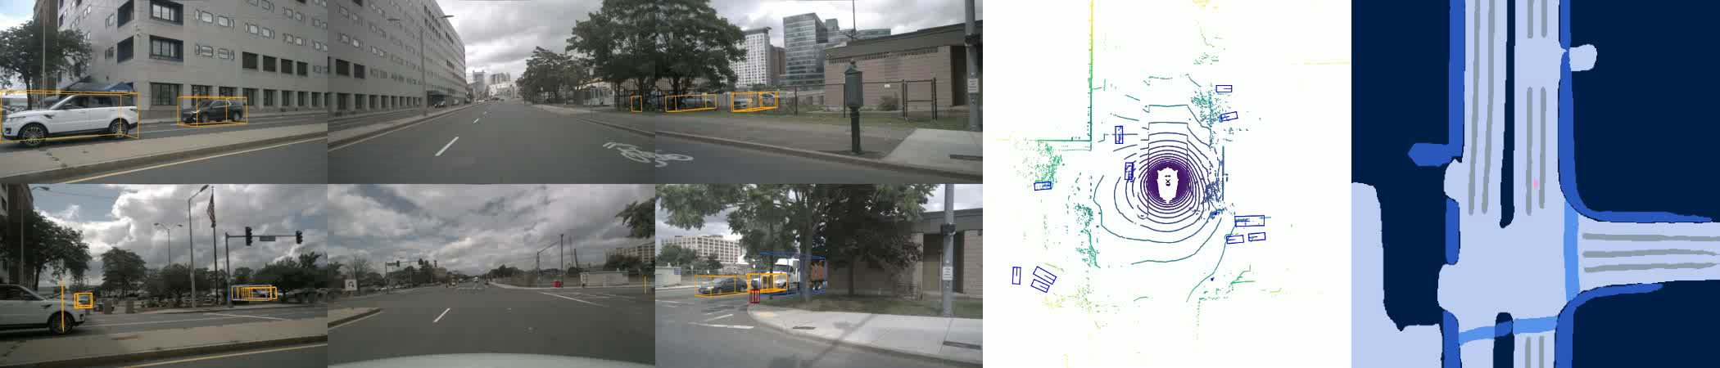
Ego3RT: Learning Ego 3D Representation as Ray Tracing
Ego3RT enables multi-task learning: 3D object detection and BEV segmentation.
3D object detection
BEV segmentation
FRONT LEFT
FRONT
FRONT RIGHT
BACK LEFT
BACK
BACK RIGHT
Car
Truck
Construction vehicle
Bus
Trailer
Pedestrian
Motorcycle
Bicycle
Barrier
Traffic Cone
Ego car
Background
Drivable area
Crossing
Walkway
Divider

Slide 18
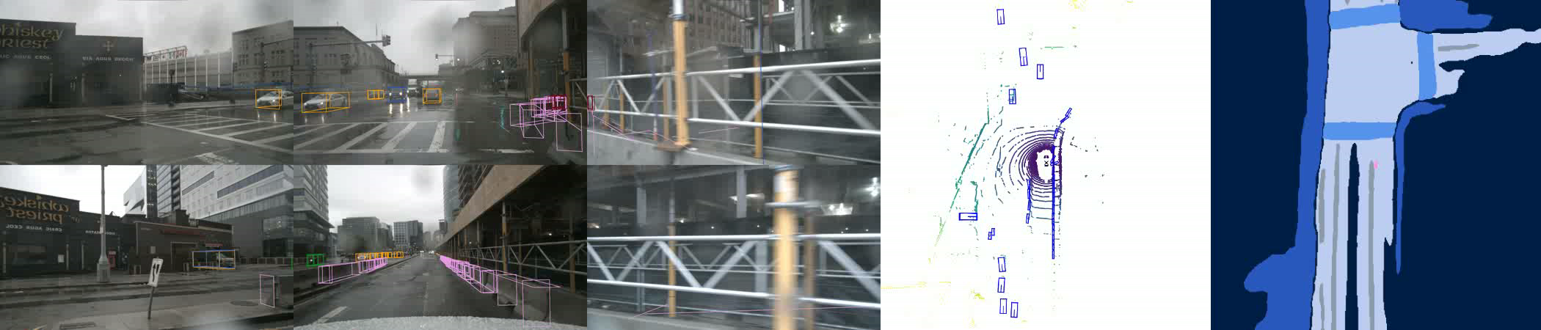
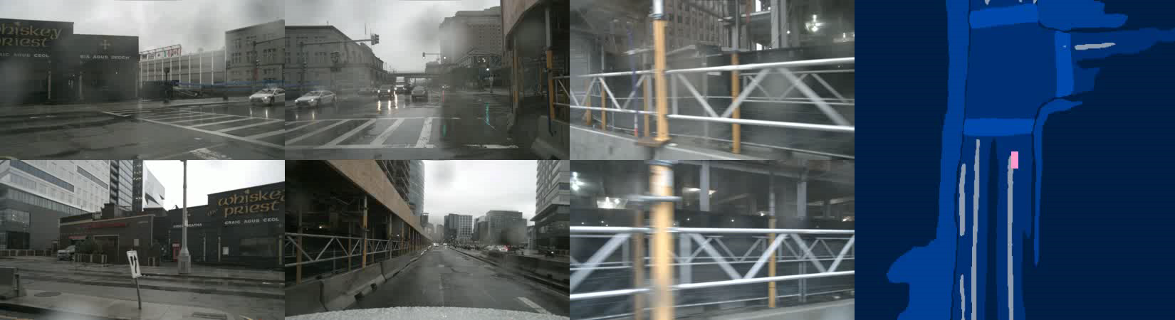
Ego3RT: Learning Ego 3D Representation as Ray Tracing
Ego3RT can handle difficult weather condition.
3D object detection
BEV segmentation
FRONT LEFT
FRONT
FRONT RIGHT
BACK LEFT
BACK
BACK RIGHT
Car
Truck
Construction vehicle
Bus
Trailer
Pedestrian
Motorcycle
Bicycle
Barrier
Traffic Cone
Ego car
Background
Drivable area
Crossing
Walkway
Divider

Slide 19
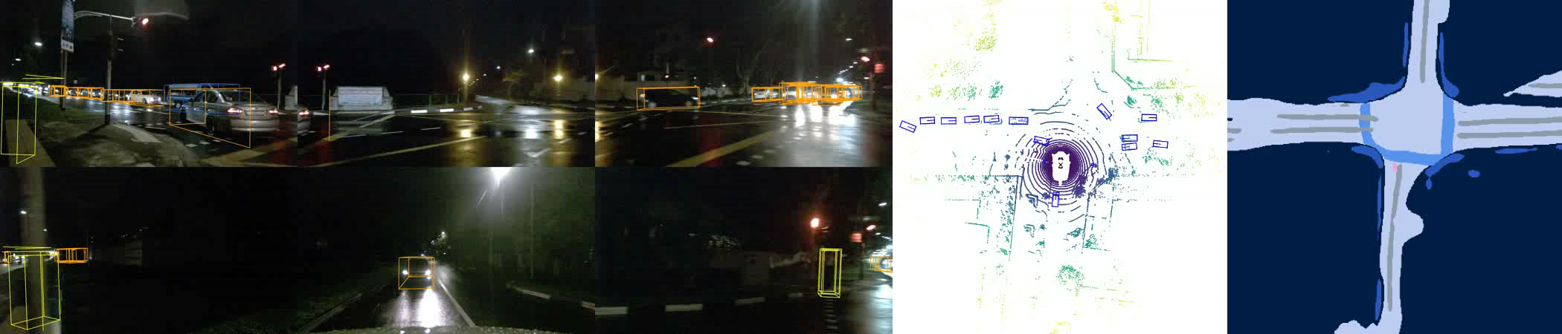
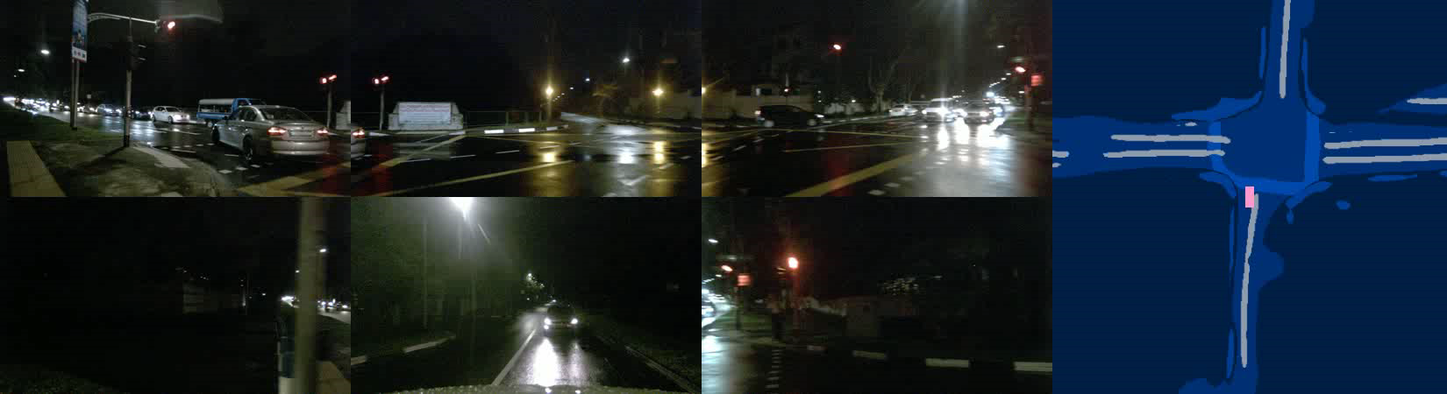
Ego3RT: Learning Ego 3D Representation as Ray Tracing
Ego3RT can handle difficult light condition.
3D object detection
BEV segmentation
FRONT LEFT
FRONT
FRONT RIGHT
BACK LEFT
BACK
BACK RIGHT
Car
Truck
Construction vehicle
Bus
Trailer
Pedestrian
Motorcycle
Bicycle
Barrier
Traffic Cone
Ego car
Background
Drivable area
Crossing
Walkway
Divider

Slide 20
Tank You
Project Page:
Github:
Address:
https://fudan-zvg.github.io/Ego3RT/
https://github.com/fudan-zvg/Ego3RT
Xinjinbo Building, 539 Handan Road, Yangpu, Shanghai, China
Paper:
E-mail:
https://arxiv.org/abs/2206.04042
jclu21@m.fudan.edu.cn

